Slide 1
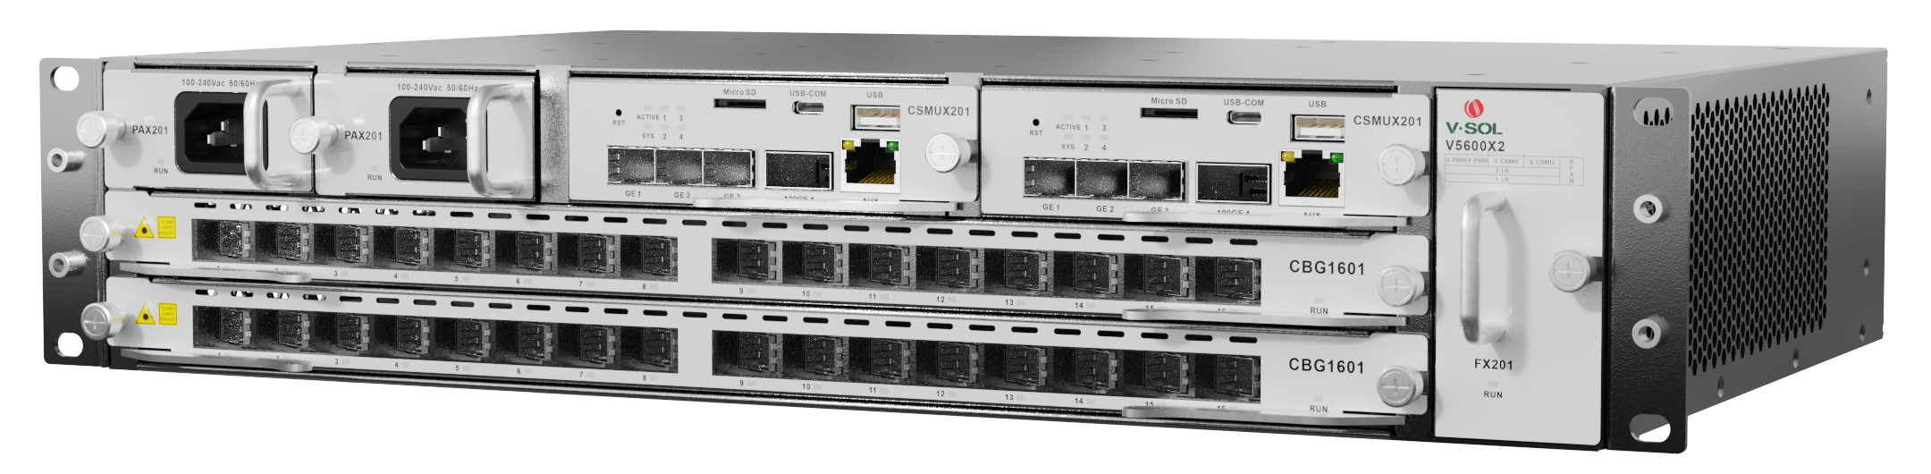



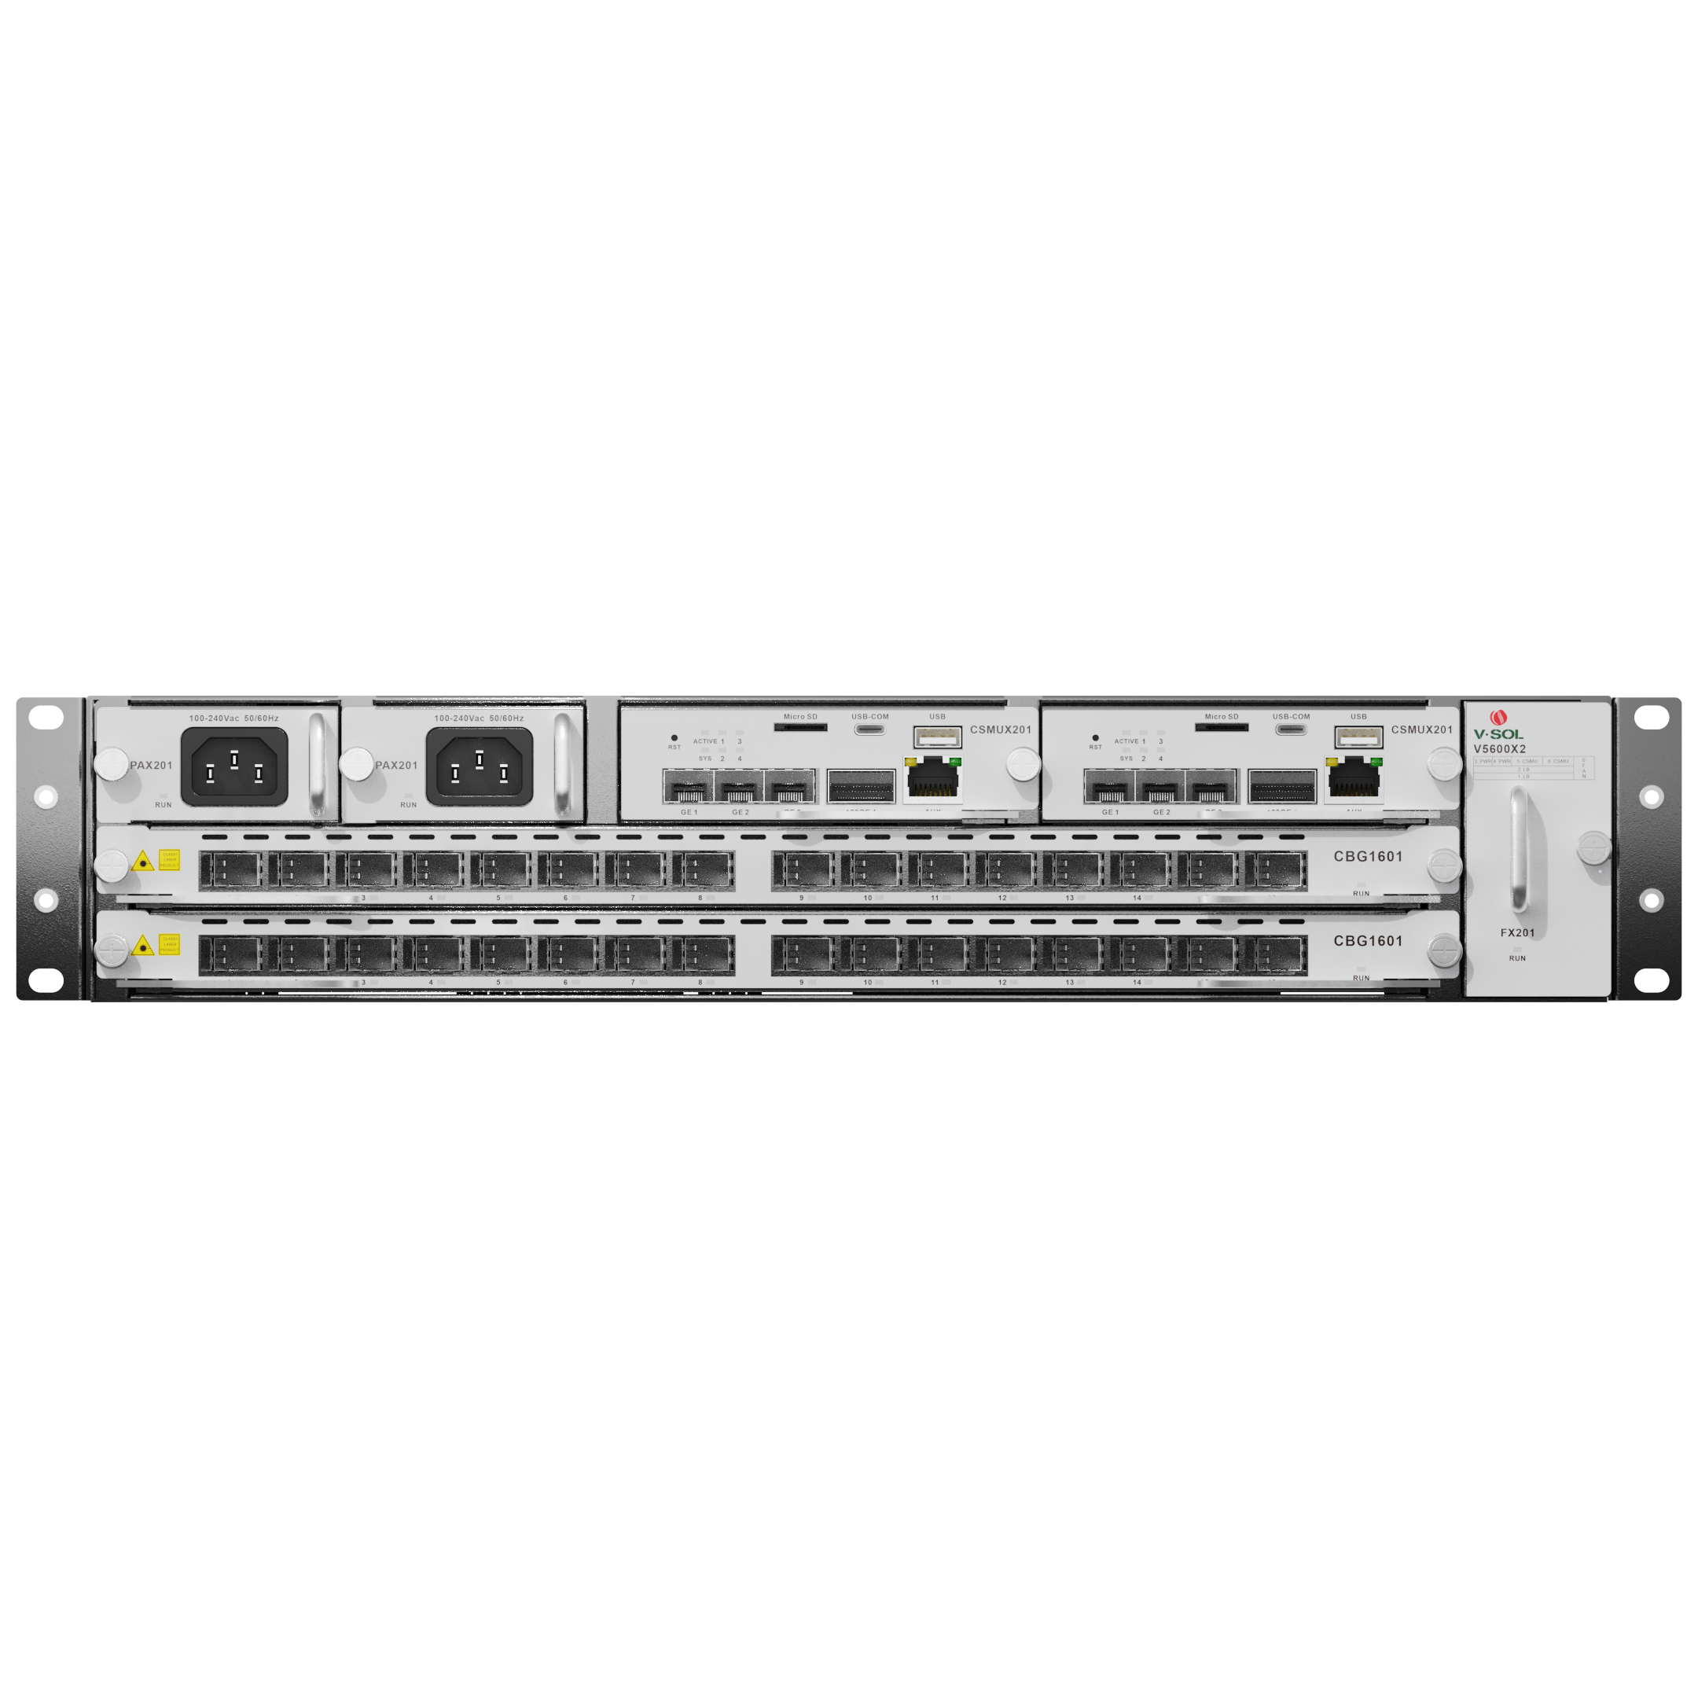
V5600X2
Chassis OLT
Highlights
High reliability
Dual-MCU Board
Type B PON Protection
Versatile Slot Configuration
Multi business slots
Simple Evolution: GPON to XG(S)-PON
Introduction:
VSOL V5600X2 are self-developed high-end chassis OLTs, which adopt high-performance chipset and complies with ITU-T international standards.V5600X2 provide multiple access methods such as GPON, XG-PON, XGS-PON and Combo PON, supports multiple network solutions such as FTTH, FTTB, FTTC, FTTD and FTTM, realizes high-bandwidth and high-speed data transmission, and meets the needs of large-scale deployment.
The product has comprehensive management and monitoring functions, simplifies the operation and maintenance process, and provide rich business functions and scalability. It provides operators with excellent user experience and high-quality services, and also meets the challenges faced by operators in the development of "wider, faster and smarter" gigabit ultra-wide networks.
Slots and Cards of V5600X2:
V5600X2
Slot 3
Power Slot
Slot 4
Slot 5
CSMU Slot
Slot 6
Fan
Slot
Slot 2
Service Slot
Slot 1
Slot 0

Slide 2
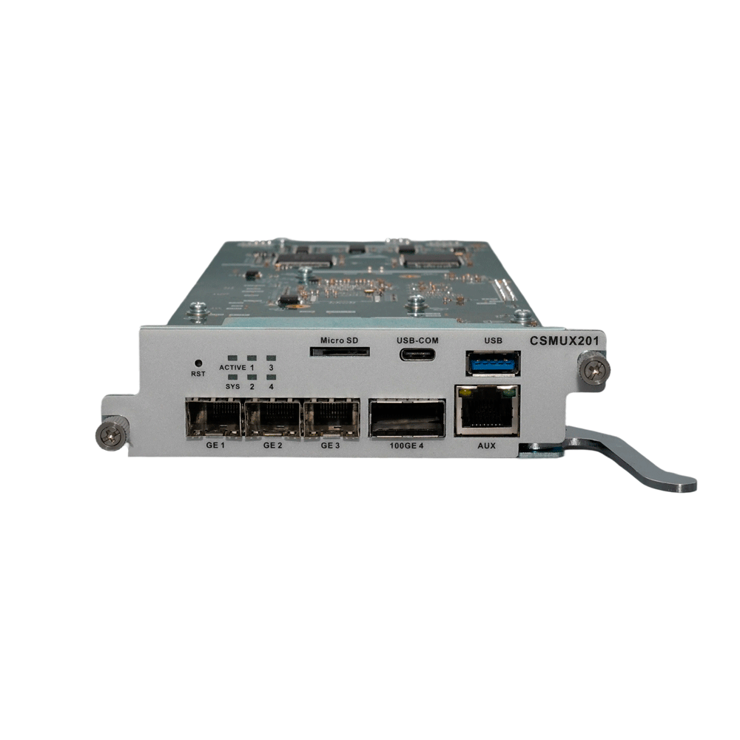
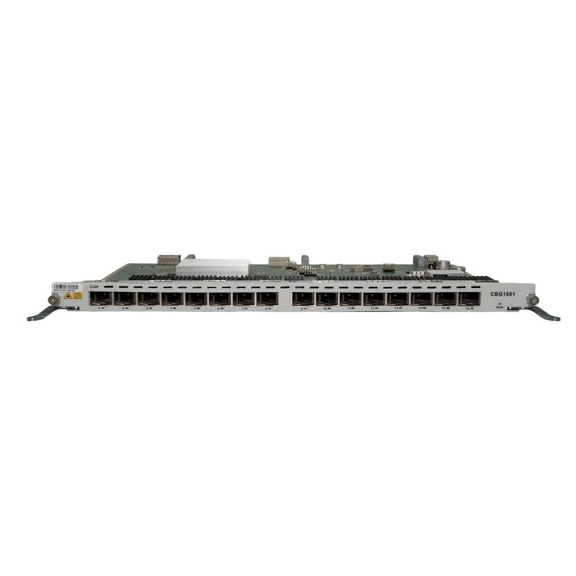
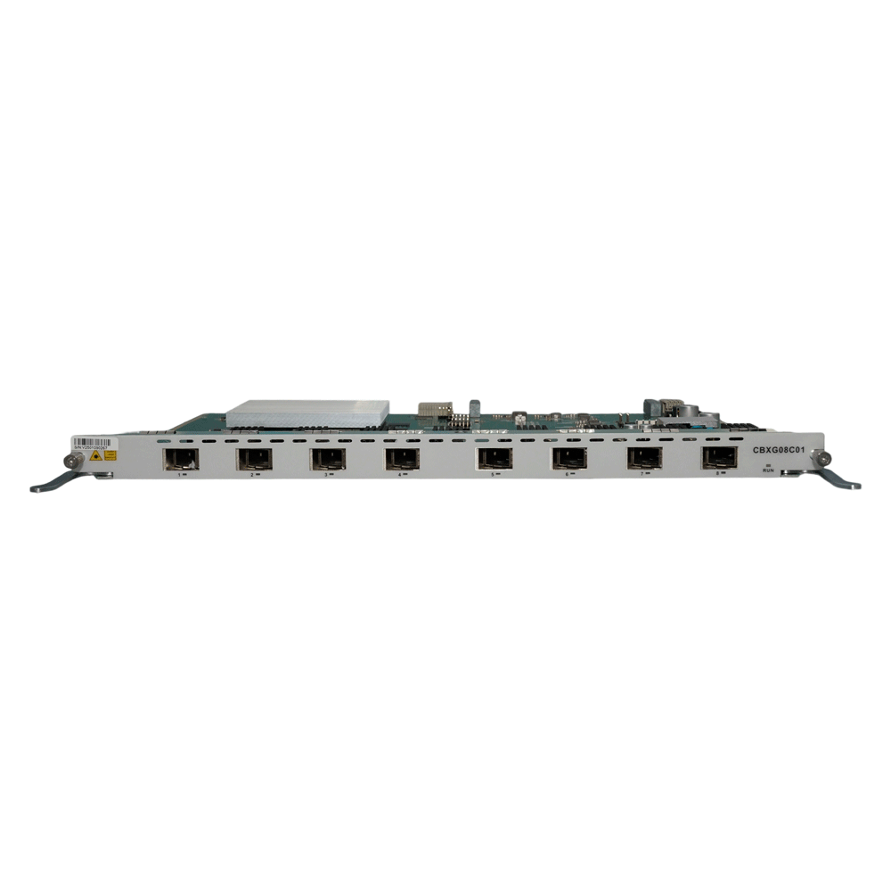
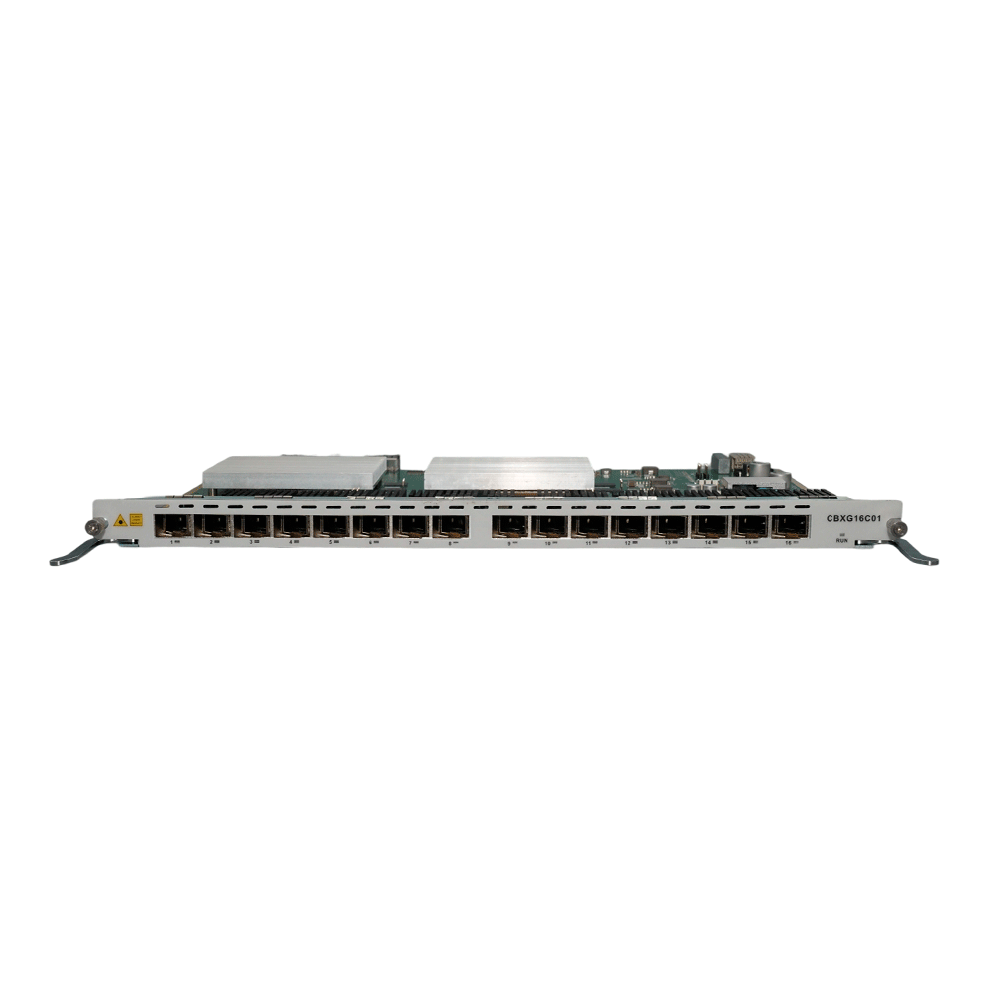
Interfaces of CSMU Card:
CSMUX201
MicroSD
USB-COM
USB3.0
AUX
1×40/50/100GE(QSFP28)
3*GE(SFP)/10GE(SFP+)
Interfaces of Service Card:
CBG1601
16*GPON ports
CBXG08C01
8*GPON&XG(S)-PON Combo PON ports
CBXG16C01
*coming soon
16*GPON&XG(S)-PON Combo PON ports

Slide 3
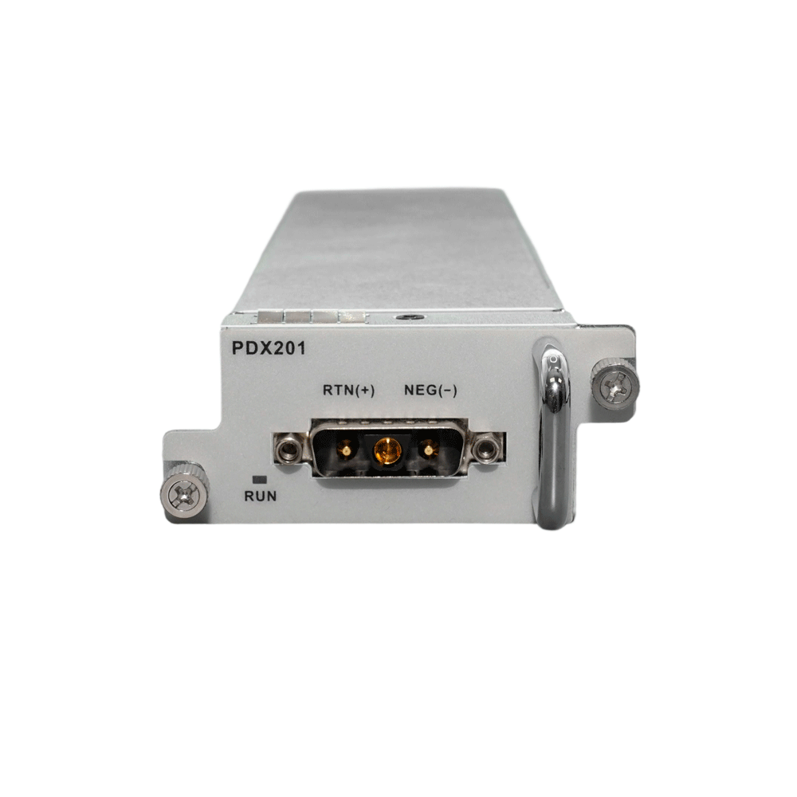
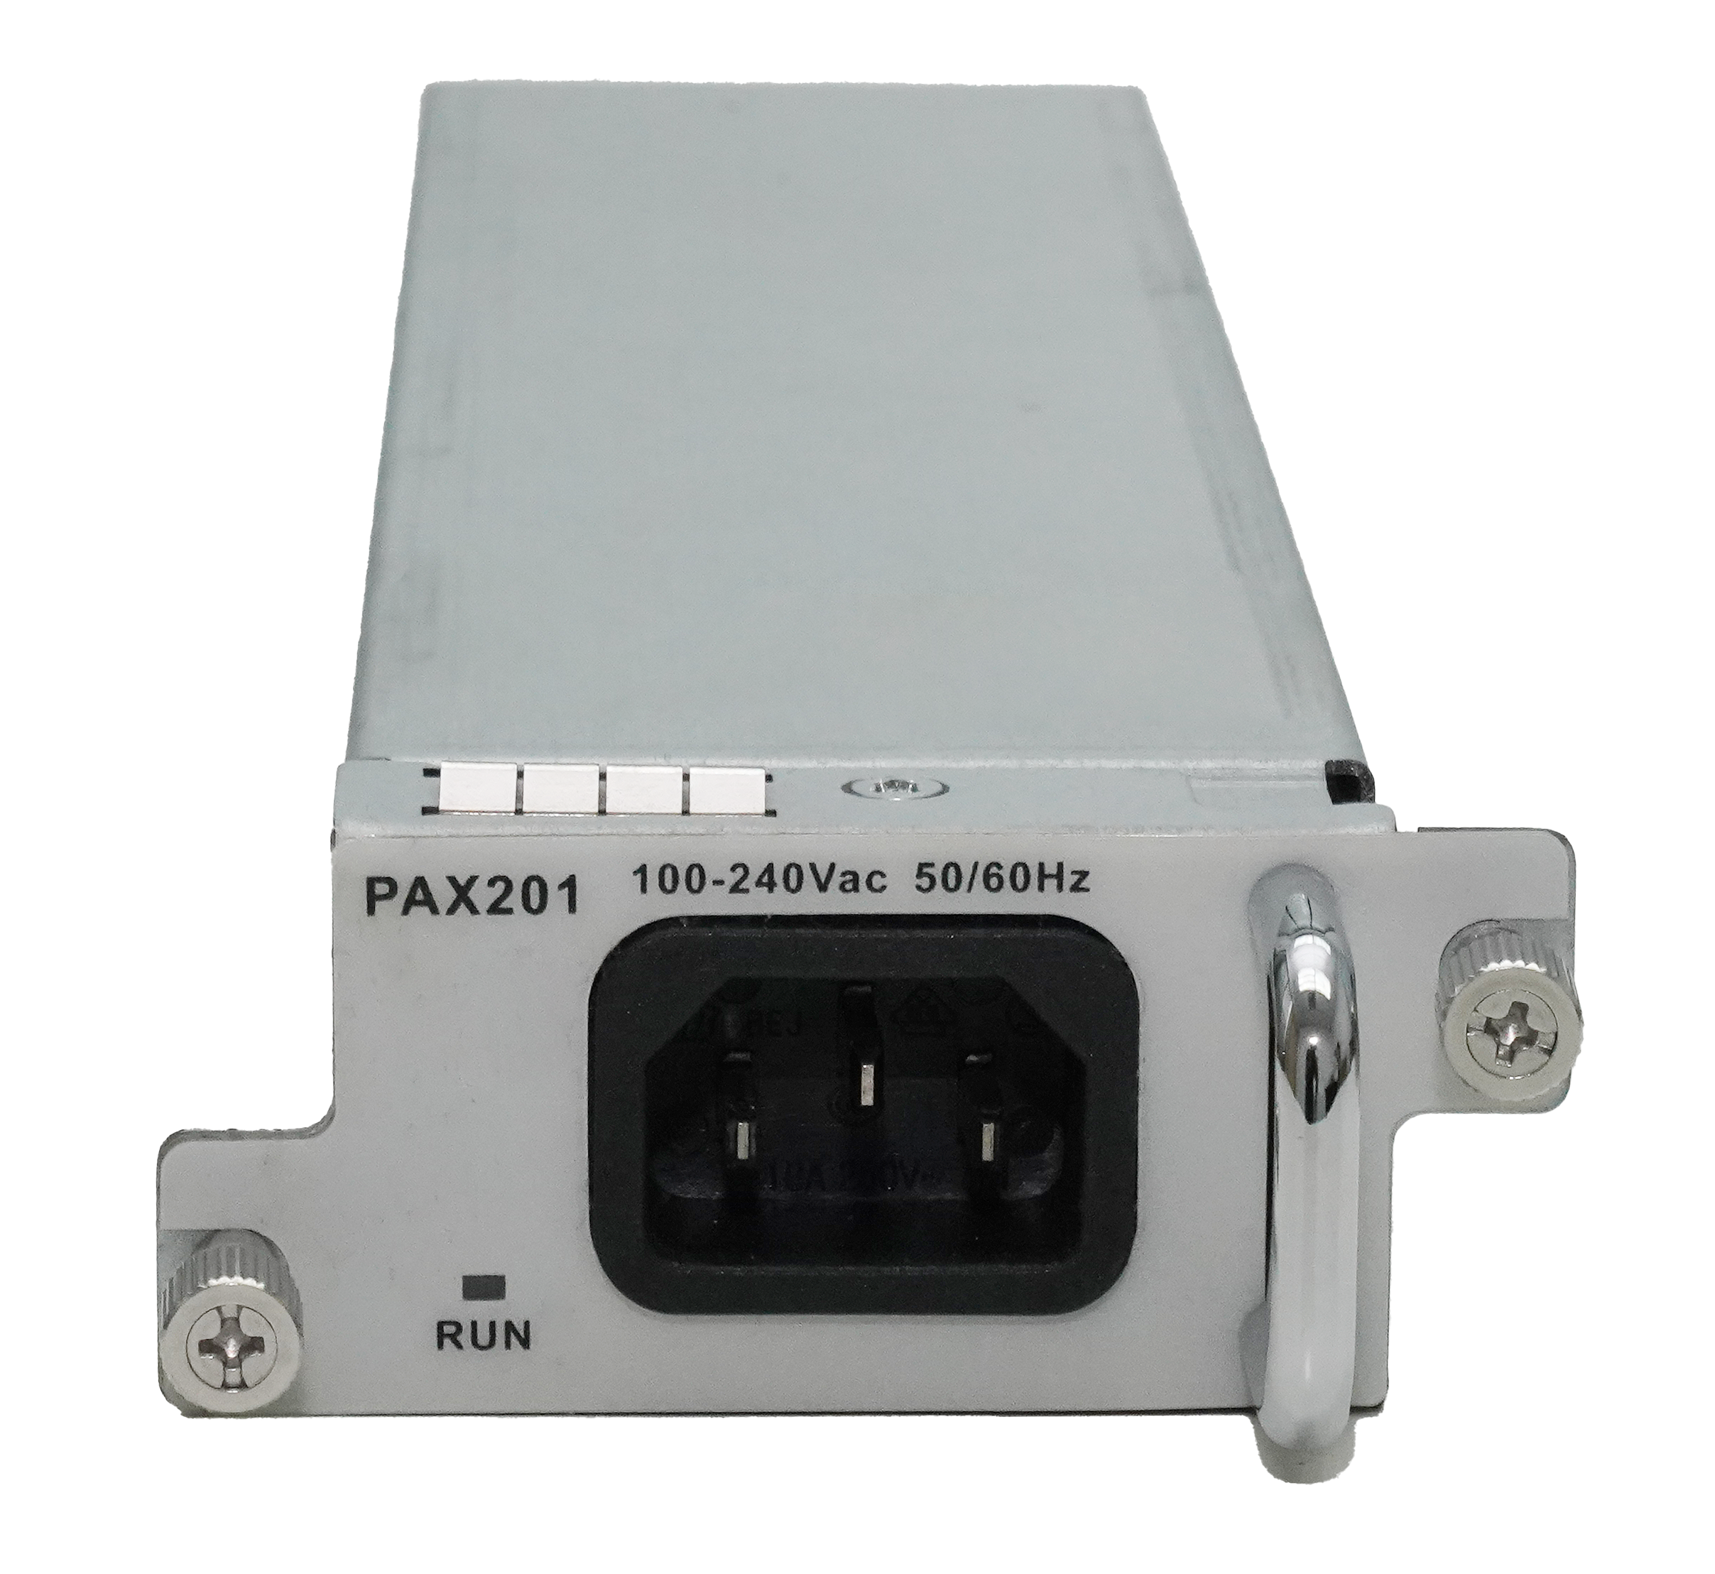
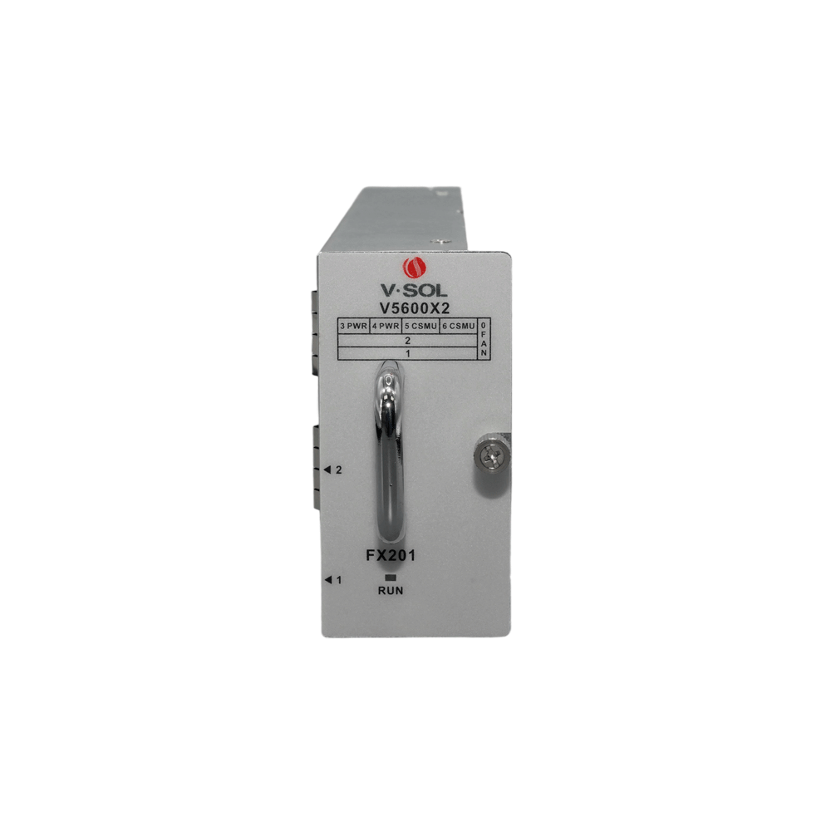
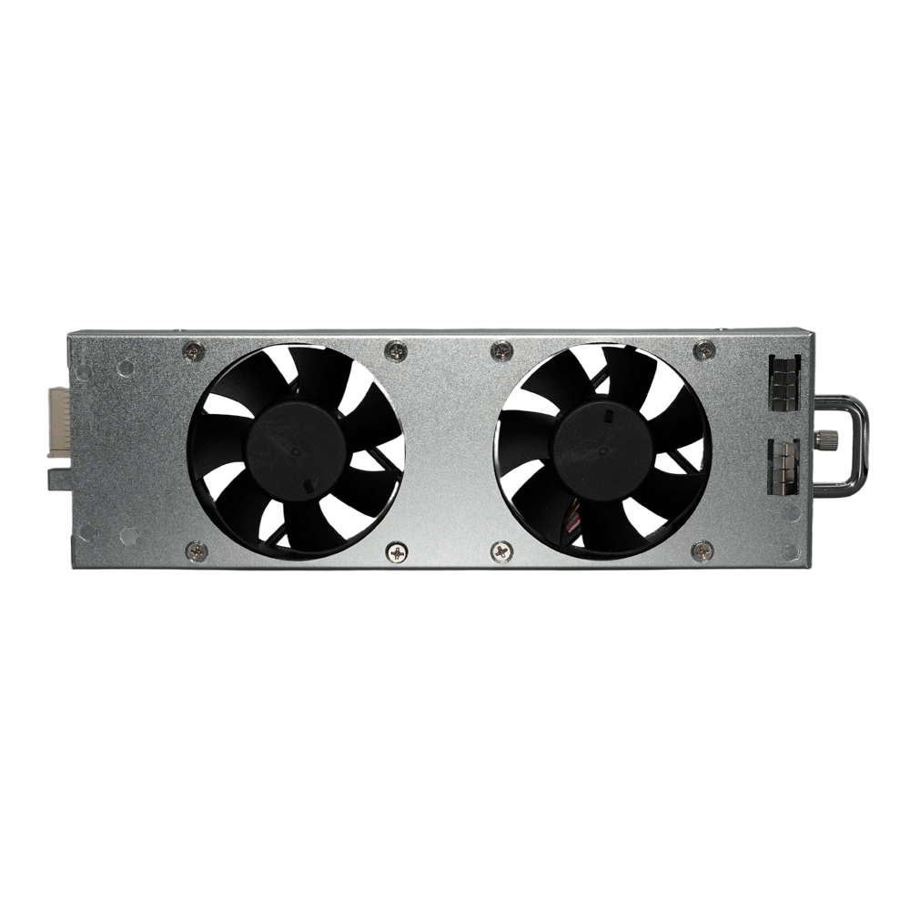
Interfaces of Power Card:
PDX201
DC 48V
PAX201
AC 100-240V
Interfaces of Fan Card:
FX201

Slide 4
Technical Specifications
Item |  | V5600X2
Chassis | Rack | 19 Inch Standard
Dimension(L*W*H) |  | 442*299*88.9mm(Without mounting ears)
Weight | Full of cards | 10.6kg
 | Chassis only | 5kg
Working Temperature |  | -20°C ~+60°C
Working Humidity |  | 5%~95%(non-condensing)
Storage Temperature |  | -40 ~ +70°C
Storage Humidity |  | 5%~95%(non-condensing)
Power Supply | DC | -48V
 | AC | 100~240VAC, 50/60Hz
Backplane Bandwidth (Gbps) |  | 1700
CSMU Card: CSMUX201
Uplink Port | QTY | 4
 | SFP(GE)/SFP+(10GE) | 3
 | QSFP28(40GE/50GE/100GE) | 1
Management Ports |  | 1*AUX(10/100/1000BASE-T out-band port), 1*MicroSD port, 1*USB-COM, 1*USB3.0
Slot position |  | Slot 5-6
Service Card: CBG1601
GPON Port | QTY | 16
 | Physical Interface | SFP Slots
 | Connector Type | Class C+++/C++++
PON Port Specification (Class C++++ module) | Transmission Distance | 20KM
 | PON Port Speed | Upstream: 1.244Gbps, Downstream: 2.488Gbps
 | Wavelength | Upstream: 1310nm , Downstream: 1490nm
 | Connector | SC/UPC
 | TX Power | +9~+13dBm
 | Rx Sensitivity | ≤ -33dBm
 | Saturation Optical Power | -8dBm
Slot position |  | Slot 1-2
Service Card: CBXG08C01
GPON&XG(S)-PON Combo Port | QTY | 8
 | Physical Interface | SFP+ Slots
 | Connector Type | N2_C+
GPON&XG(S)-PON Combo Port Specification (N2_C+ module) | Transmission Distance | 20KM
 | XG(S)-PON Port Speed | GPON: Upstream1.244Gbps, Downstream 2.488Gbps XG-PON: Upstream 2.488Gbps, Downstream 9.953Gbps XGS-PON: Upstream 9.953Gbps, Downstream 9.953Gbps
 | Wavelength | GPON: Upstream 1310nm , Downstream 1490nm XG(S)-PON: Upstream 1270nm , Downstream 1577nm
 | Connector | SC/UPC
 | TX Power | GPON: +3dBm ~ +7dBm , XG(S)PON: +4dBm ~ +7dBm
 | Rx Sensitivity | XGS-PON: -28dBm , XG-PON: -29.5dBm , GPON: -32dBm
 | Saturation Optical Power | XGS-PON: -7dBm , XG-PON: -9dBm , GPON: -12dBm
Slot position |  | Slot 1-2
Service Card: CBXG16C01
GPON&XG(S)-PON Combo Port | QTY | 16
 | Physical Interface | SFP+ Slots
 | Connector Type | N2_C+
GPON&XG(S)-PON Combo Port Specification (N2_C+ module) | Transmission Distance | 20KM
 | XG(S)-PON Port Speed | GPON: Upstream1.244Gbps, Downstream 2.488Gbps XG-PON: Upstream 2.488Gbps, Downstream 9.953Gbps XGS-PON: Upstream 9.953Gbps, Downstream 9.953Gbps
 | Wavelength | GPON: Upstream 1310nm , Downstream 1490nm XG(S)-PON: Upstream 1270nm , Downstream 1577nm
 | Connector | SC/UPC
 | TX Power | GPON: +3dBm ~ +7dBm , XG(S)PON: +4dBm ~ +7dBm
 | Rx Sensitivity | XGS-PON: -28dBm , XG-PON: -29.5dBm , GPON: -32dBm
 | Saturation Optical Power | XGS-PON: -7dBm , XG-PON: -9dBm , GPON: -12dBm
Slot position |  | Slot 1-2

Slide 5
Technical Specifications
Management Function
Telnet,CLI,WEB,SSH v2
Fan Group Control
Port Status monitoring and configuration management
Online ONTconfiguration and management
User management
Alarm management
Support ACL and SNMP to configure data packet filter flexibly
Specialized design for system breakdown prevention to maintain stable system
Support STP,RSTP,MSTP
Support Radius,Tacacs+
Support IP source guard
Support static route ,dynamic route RIP v1/v2,RIPng and OSPF v2/v3
IPv6
Support NDP
Support IPv6 Ping,IPv6 Telnet,IPv6 routing
Support ACL based on source IPv6 address, destination IPv6 address, L4 port, protocol type, etc
Multicast
IGMP v1/v2, IGMP snooping/Proxy
MLD v1 snooping/Proxy
DHCP
DHCP server,DHCP relay,DHCP snooping
DHCP option82
Security
Support power backup
Support CSM 1+1 redundancy
Support Type B PON protection
Support IEEE 802.1x, AAA, Radius and Tacas+
Layer2 Switch
32K Mac address
Support 4096 VLANs
Support port VLAN
Support VLAN translation and QinQ
Support storm control based on port
Support port isolation
Support port rate limitation
Support 802.1D and 802.1W
Support static LACP,Dynamic LACP
QoS based on port, VID, TOS and MAC address
Access control list
IEEE802.x flowcontrol
Port stability statistic and monitoring
Layer 3 Route
ARP proxy
Hardware Host Routes: IPv4 32K, IPv6 16K
Hardware Subnet Routes: IPv4 24K, IPv6 12K
PON Function
T-CONT DBA
x-GEM traffic
In compliant with ITU-T G.9807(XGS-PON) , ITU-T G.987(XG-PON) and ITU-T984.x
Up to 20KM transmission Distance
Support data encryption, multi-cast, port VLAN, etc
Support ONT auto-discovery/link detection/remote upgrade of software
Support VLAN division and user separation to avoid broadcast storm
Support power-off alarm function, easy for link problem detection
Support broadcasting storm resistance function
Support port isolation between different ports
Ordering Information:
Product Name | Product Description | Specific
V5600X2 chassis | Chassis of OLT | /
CSMUX201 | CSMU Card | 1*40/50/100GE(QSFP28)+3*GE(SFP)/10GE(SFP+) +1*AUX+1*MicroSD+1*USB-COM+1*USB3.0
CBG1601 | Service Card | 16*GPON ports
CBXG08C01 | Service Card | 8*GPON&XG(S)-PON Combo PON ports
CBXG16C01 | Service Card | 16*GPON&XG(S)-PON Combo PON ports
PDX201 | Power Supply Card | DC -48V
PAX201 | Power Supply Card | AC 220V, 50/60Hz
FX201 | Fan tray | /
Official Website: https://www.vsolcn.com/ E-mail: marketing@vsolcn.com support@vsolcn.com

