Slide 1
Biometric Solutions
Name of Presenter
Technical Presentation

Slide 2
About Us
35 years of experience
In-house R&D teams
Fully-owned world-class manufacturing facilities
USA | CHINA | ISRAEL

Slide 3
Worldwide Presence
Beijing
Dallas
Israel
Shanghai
Xi’an
India
Shenzhen
Hong Kong
Colombia
Argentina

Slide 4
Partners

Slide 5
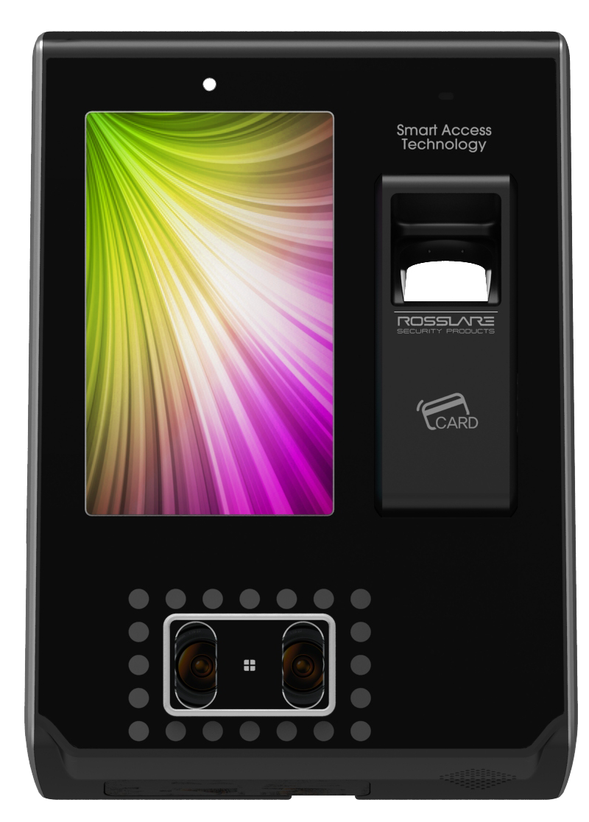
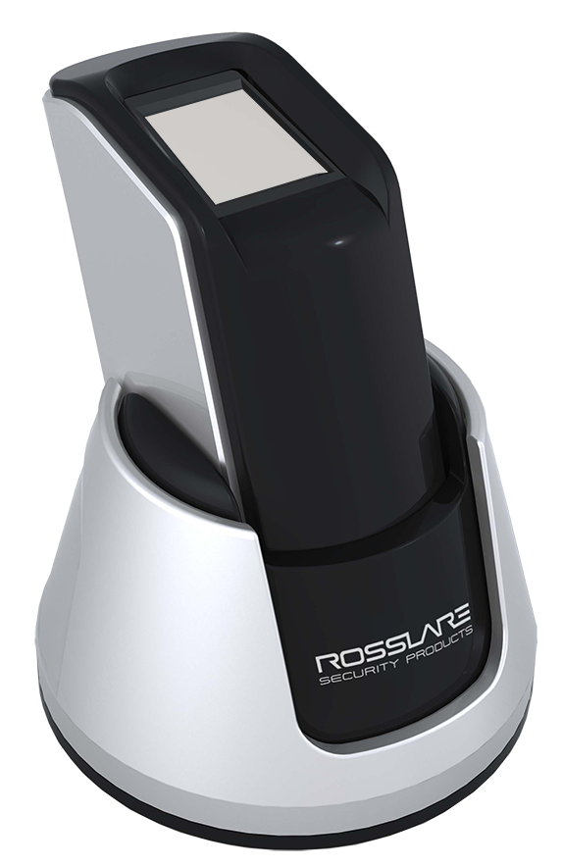
AY-B91x0BT
AY-B92x0BT
AY-B9350
DR-9000
9000 Biometric Series

Slide 6
9000 Biometric Series
General
20,000 fingerprint templates, 10,000 users
Support Wiegand 26- and 34-Bit formats
Built-in output relay for controlling a local door
RosslareBio 9000 Client/Server software
Support Rosslare BLE-ID and BLE-Admin apps (selected modules)
Face recognition (AY‑B9350)

Slide 7
9000 Biometric Series
Compression Table
 | AY-B9120BT | AY-B9150BT | AY-B9250BT | AY-B9350
Templates | 20,000 | 20,000 | 20,000 | 20,000
Users | 10,000 | 10,000 | 10,000 | 10,000
EM | V | X | X | V
MIFARE (CSN) | X | V | V | V
BLE | V | V | V | X
Face Recognition | X | X | X | V
Snap Shot Camera | X | X | V | X
Door Relay | V | V | V | V
Multi-level Authentication | Card / FP | Card / FP | Card / FP | Card / FP / Face / Code
Notes:
Multi Levels Authentication – refer to “OR” / “AND” working mode, in AND mode all levels are require, this mean the if a user using card, FP, Face and code all 4 will be need to gain access

Slide 8
AY-B9120BT/9150BT

Slide 9
AY-B9120BT/9150BT
General
AY-B9120 BT – Supports 125 kHz
AY-B9150 BT – Supports 13.56 MHz (MIFARE Classic)
Must use the AY-B91x0 power supply
Recommended cable – 22AWG
IP address can be set up using BLE-Admin app or RosslareBio 9000 software (LAN only)

Slide 10
AY-B9120BT/9150BT
Terminal Description
LED
Fingerprint Sensor
RF ID Reader

Slide 11
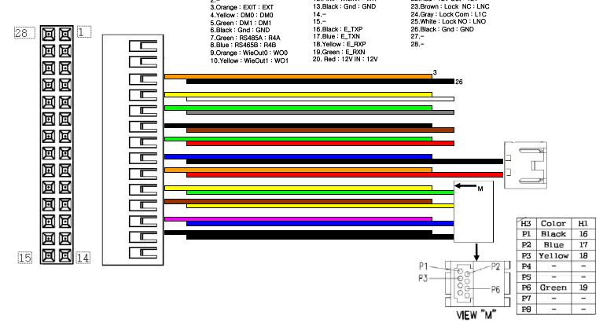
AY-B9120BT/9150BT
Wiring
Power and Ethernet
Power Supply
Ethernet RJ-45

Slide 12
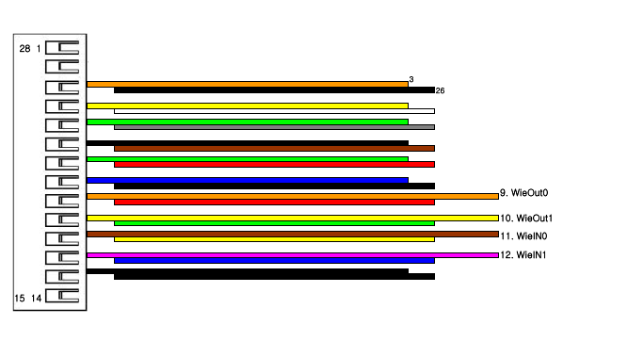
AY-B9120BT/9150BT
Wiring
Wiegand
To Controller
DO
D1
GND

Slide 13
AY-B9120BT/9150BT
Set to Factory Default
Power off the AY-B91x0BT
Connect the yellow wire (WO 1) to pink wire (WI 1)
Connect the orange wire (WO 0) to brown wire (WI 0)
Power on the AY-B91x0BT
The device is set to factory default now

Slide 14
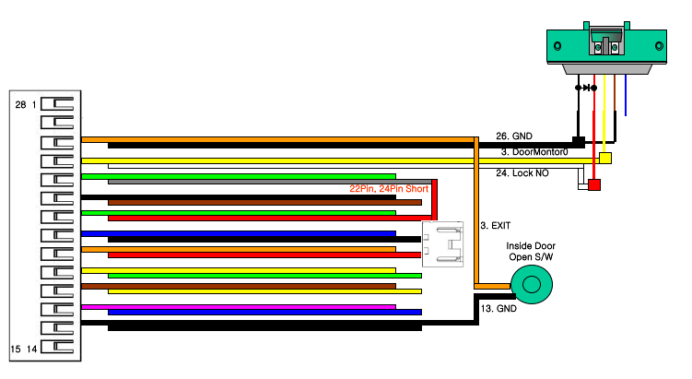
AY-B9120BT/9150BT
Wiring
Lock Connection – while using as Standalone

Slide 15
AY-B9250BT

Slide 16
AY-B9250BT
General
Support 13.56 MHz (MIFARE Classic)
On terminal display
User ID
Time
Function keys
4 buttons for configuration
Recommended cable – 22AWG
Built-in camera for access event snap shots

Slide 17
AY-B9250BT
Terminal Description
LED
Camera
LCD Display
Function Buttons
Fingerprint Sensor
RF ID Reader

Slide 18
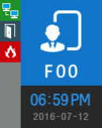
AY-B9250BT
Terminal Screen Description
Network Status
Door Status
Fire Alarm
Function Key
Time / Date

Slide 19
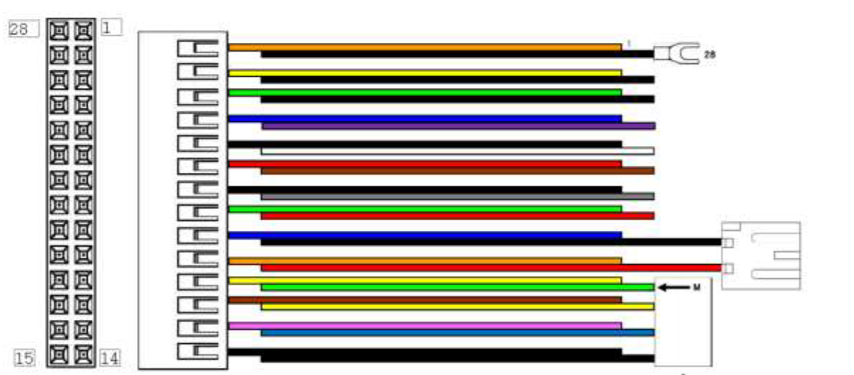
AY-B9250BT
Wiring
Power and Ethernet
Power Supply
Ethernet RJ-45

Slide 20
AY-B9250BT
Wiring
Wiegand
To Controller
10
DO
11
D1
GND

Slide 21
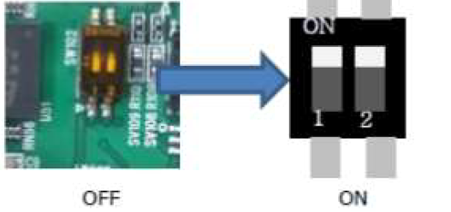
AY-B9250BT
Set to Factory Default
Power off the AY-B9250BT
On the back side of the terminal set the 2 dipswitches to ON:
Power on the AY-B9250BT
After the terminal completely boots, press [F1] longer to enter the menu with the buzzer sound “Ppiririk”.

Slide 22
AY-B9350BT

Slide 23
AY-B9350
General
Support 13.56 MHz (MIFARE Classic) and 125 kHz (EM)
Touch screen
Face recognition using 2 cameras
Recommended cable – 22AWG (max 15 meters from power supply)

Slide 24
AY-B9350
Terminal Description
Light Sensor
Fingerprint Sensor
Touch Screen
RF ID Reader
Dual Camera Face Recognition
IR LEDs

Slide 25
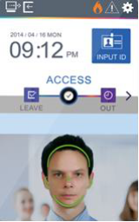
AY-B9350
Terminal Screen Description
Network Status
Door Status
Warnings
Time / Date
Input ID
T&A selector
Camera Video
Face Detection

Slide 26
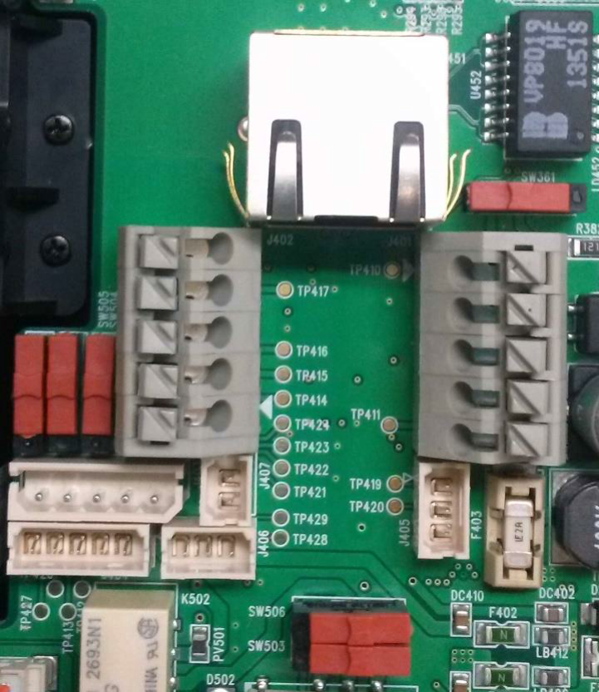
AY-B9350
Wiring
Power and Ethernet
Ethernet RJ-45
Power Supply

Slide 27
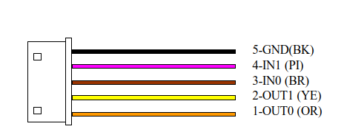
AY-B9350
Wiring
Wiegand
Wiegand Cable
To Controller
GND
D1
DO

Slide 28
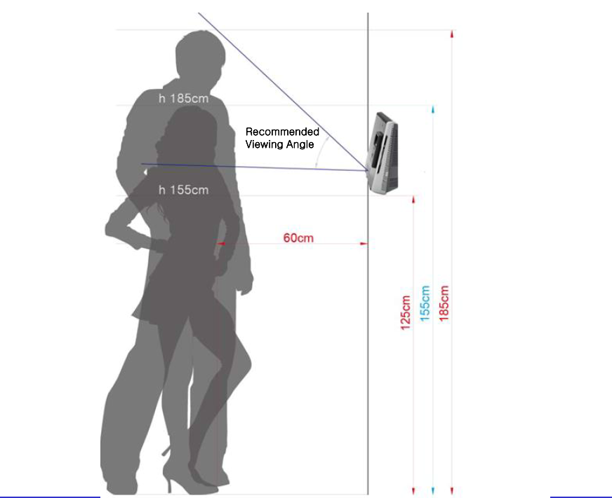
AY-B9350
Installation – Recommended Height
Terminal mounting plate (recommended)

Slide 29
AY-B9350
Installation – Limitations
Install the device indoors
Do not install under an incandescent light
Do not install where there is direct sunlight or counter-light

Slide 30
DR-9000

Slide 31
DR-9000
General
Desktop fingerprint enrollment device
Supports RosslareBio 9000 management SW
USB 2.0 connectivity
Win OS support
Scratch-proof surface
Crystal clear finger scan images
Driver installation needed

Slide 32
9000 Biometric Series
Fingerprint Enrollment
Correct fingerprint input method
Make sure that the fingerprint is clear and not wounded

Slide 33
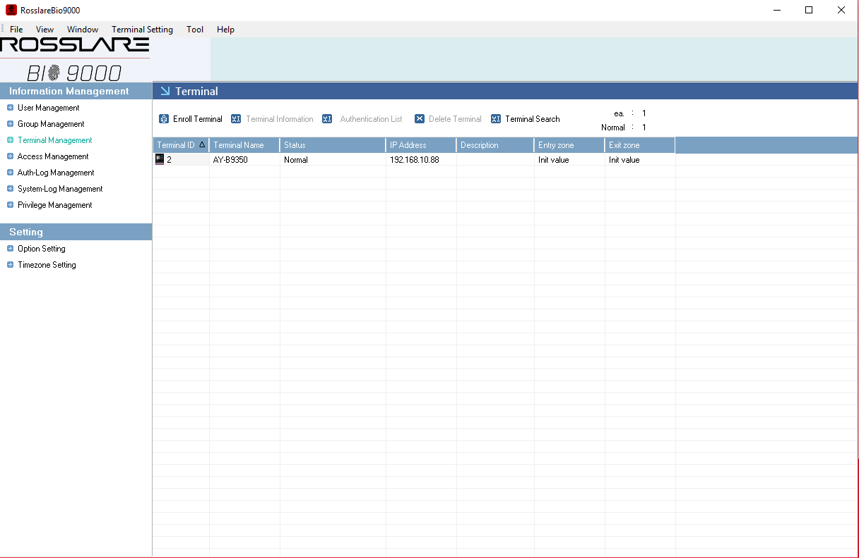
RosslareBio 9000 – Management Software

Slide 34
RosslareBio 9000
General
Supports multiple terminals
Supports any Windows based OS
Supports DR-9000 enrollment device (DR-9000)
User management
Fingerprint management
Time and Attendance
Time zones
MS-SQL DB (for SQL Server settings, please see SQL Servers setting section on this presentation)

Slide 35
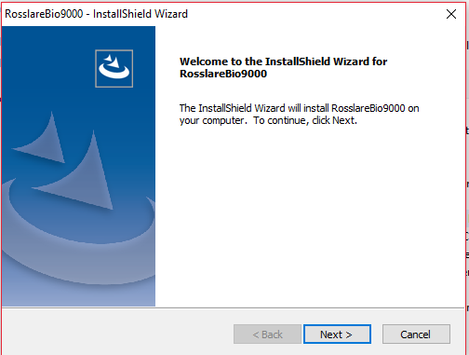
RosslareBio 9000
Installation
Run the installation software
Click Next

Slide 36
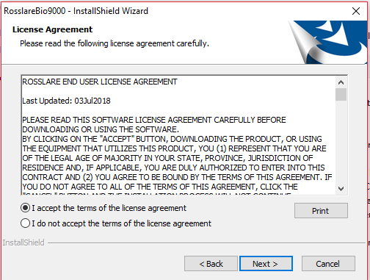
RosslareBio 9000
Installation
1. Accept
2. Click Next

Slide 37
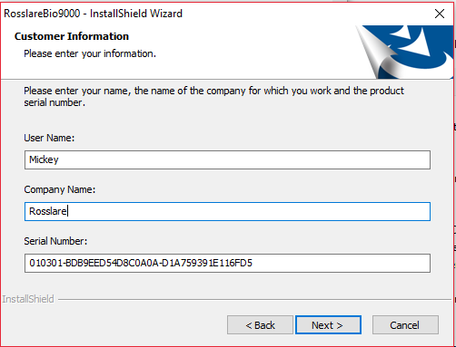
RosslareBio 9000
Installation
Enter the details
Serial Number - 010301-BDB9EED54D8C0A0A-D1A759391E116FD5 for all installation
1. User Name
2. Company Name
3. Serial number
4. Click Next

Slide 38
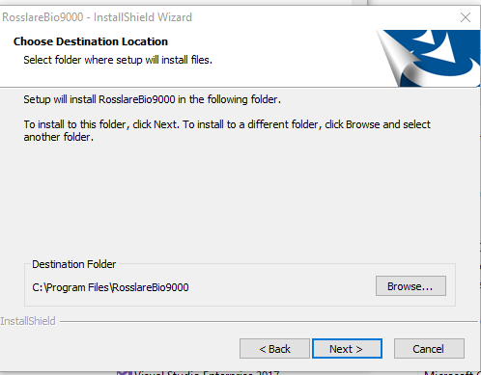
RosslareBio 9000
Installation
Confirm installation folder
Click Next

Slide 39
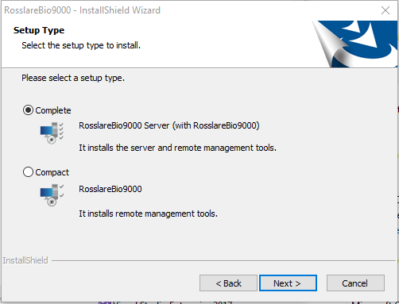
RosslareBio 9000
Installation
Select installation type
Local server and client
Client only – connected to remote server
Click Next

Slide 40
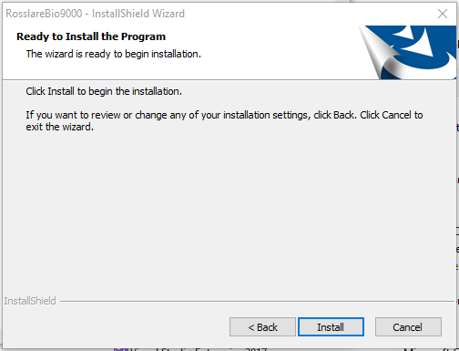
RosslareBio 9000
Installation as Server
Click Install
Click Install

Slide 41
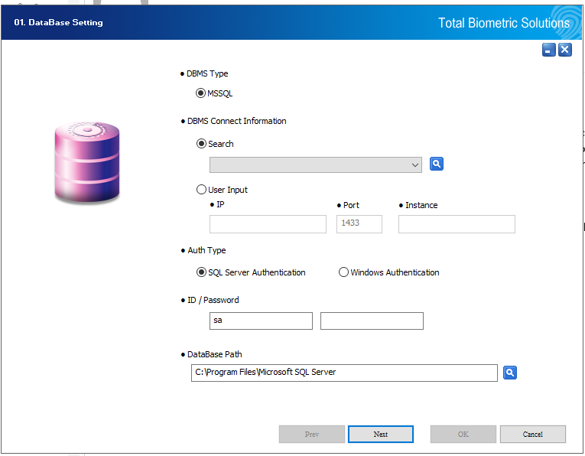
RosslareBio 9000
Installation as Server
Set SQL connection
For SQL Server pre-setting, see SQL server setting at the end of this presentation
SQL Server Details
Authentication Details – Must use sa
Click Search for Path
Click Next
Notes:
SQL server Details:
Name from list or IP (localhost can be used)
For AxTraxNG Default DB use
IP – localhost
Instance - VERITRAX
SQL Authentication details – Must use SA

Slide 42
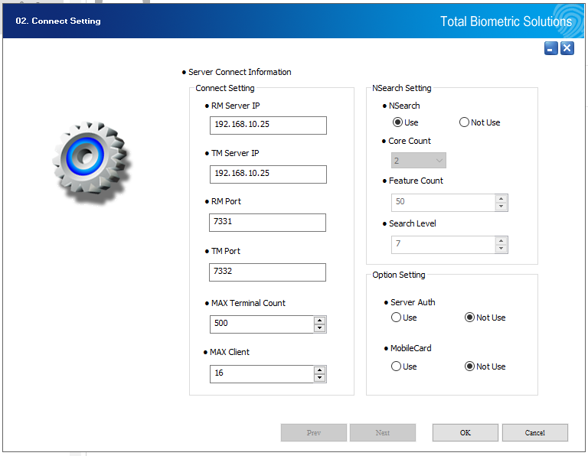
RosslareBio 9000
Installation as Server
Set Server connection
Client Connection IP
Terminals Connection IP
Client Connection port
Terminals Connection port
Terminals per Server
Remote Clients
Click OK
Notes:
Max Terminal – not more than 1000 per server
Max Client –not more than 50 per server

Slide 43
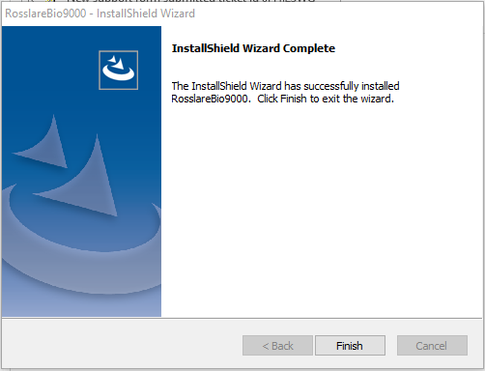
RosslareBio 9000
Installation
Complete installation
Click Finish

Slide 44
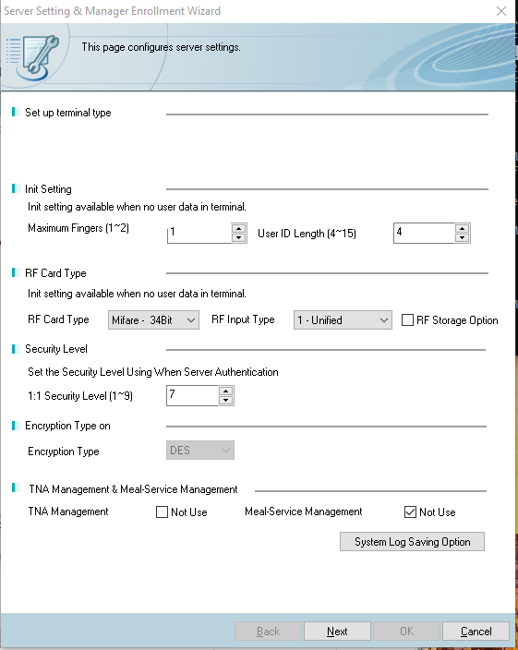
RosslareBio 9000
First Run Setting
FP and ID
Card Reading setting
Security Level
Encryption Type
Time & Attendance
Remote Clients
Click Next
Notes:
Default Values cannot be modified after it been changed!
Card Reading setting recommended to use Wiegand 22bit and unified
Security level – for server authentication mode – only when need to use server DB for authentication – default mode is terminal DB.
Default Time and Attendance mode is “not use” to enable un mark the not use.

Slide 45
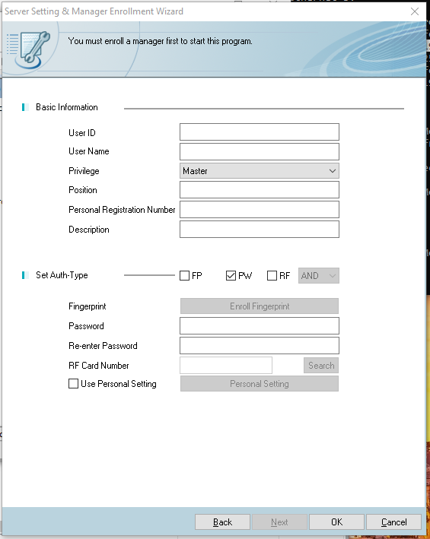
RosslareBio 9000
First Run Setting
User Information
Authentication
Click OK
Notes:
User Information: this is the first user\ operator in the system and will be use for login the SW till more user with “Master” rights are set.
User ID – Should not be all “0” and ID following the setting on prev. section is allowed
User Name – any Text
Privilege – user rights – for first user should be Master
Position – Text
Personal Registration Number – usually ID number
Description – Text
Authentication
Authentication Type FP/ PW/ Card – for first user keep it to password and Numbers only
User password

Slide 46
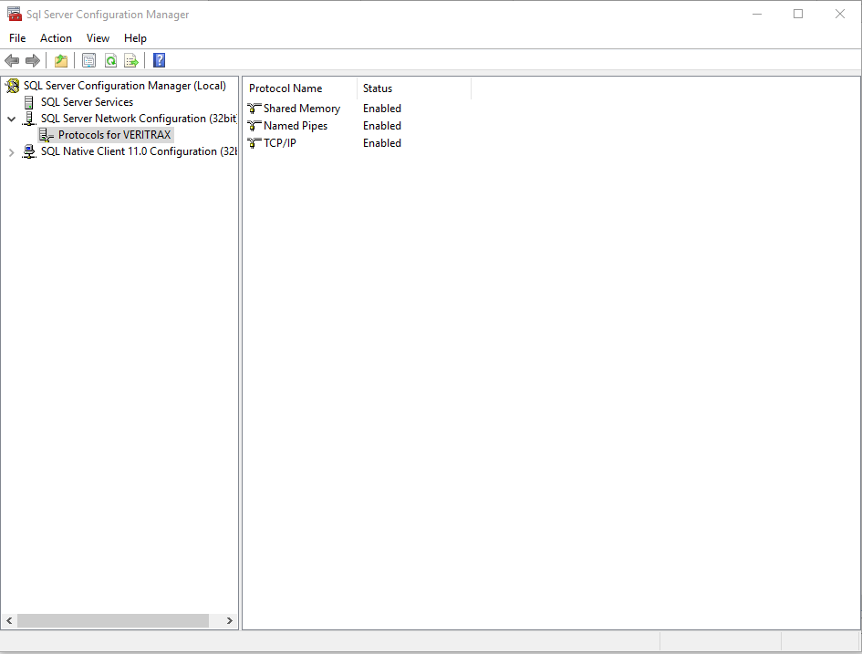
RosslareBio 9000
SQL Server Setting
Open the SQL Server Configuration Manager.
Brows to “Protocols for XXXXX (default VERITRAX)
Instance protocols

Slide 47
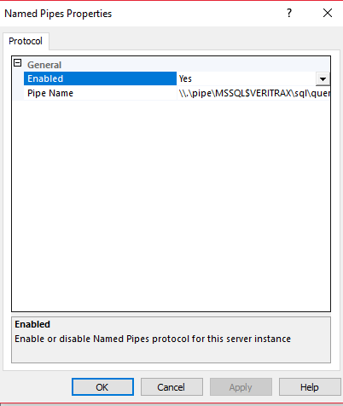
RosslareBio 9000
SQL Server Setting
Double-click on “Named Pipe”
Under protocol Tab, make sure “Enabled” is set to ”Yes”

Slide 48
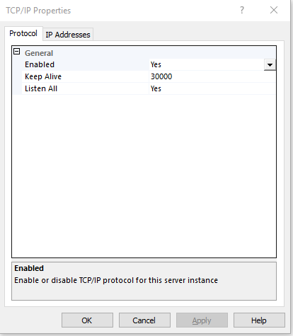
RosslareBio 9000
SQL Server Setting
Double-click on “TCP/IP”
Under protocol Tab, make sure “Enabled” is set to ”Yes”

Slide 49
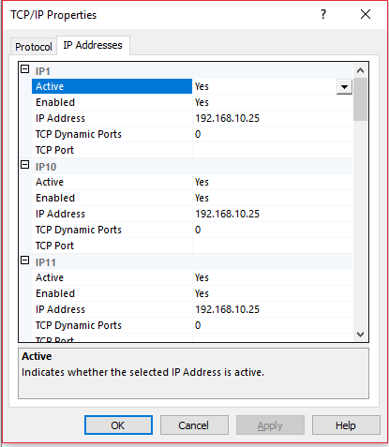
RosslareBio 9000
SQL Server Setting
On IP Addresses tab, make sure all listed IPs are Active, Enabled, and IP address is set to PC IP Address
Click Apply

Slide 50
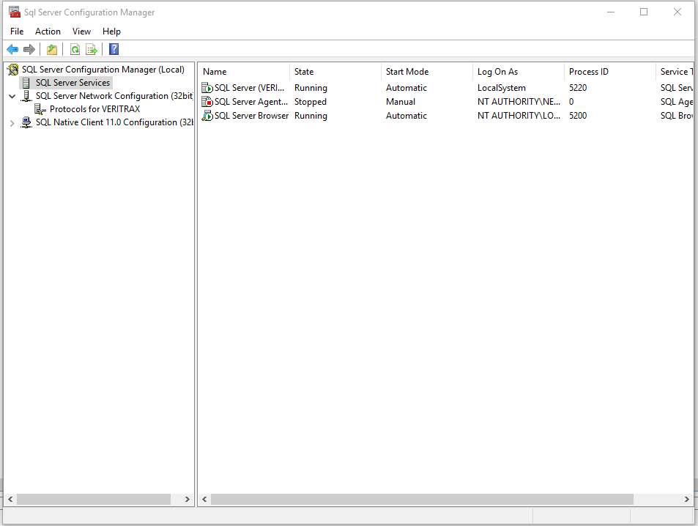
RosslareBio 9000
SQL Server Setting
Go to SQL Server Services topic
Server Services

Slide 51
RosslareBio 9000
SQL Server Setting
Make sure SQL Server Browser is Running

Slide 52
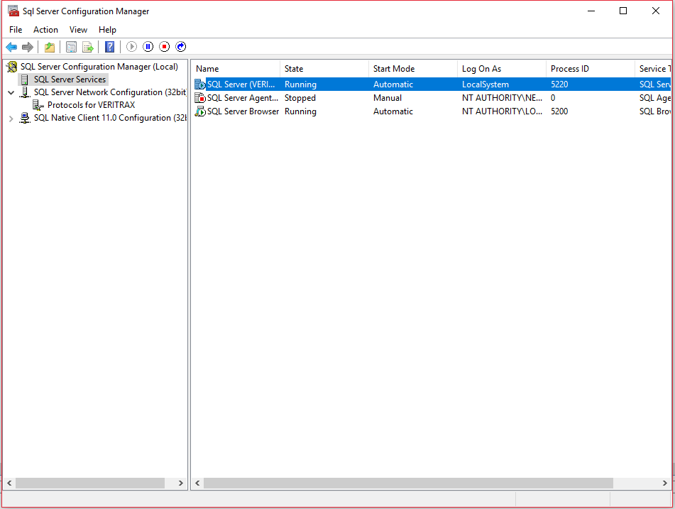
RosslareBio 9000
SQL Server Setting
Select SQL Server (Instance Name)
Click Restart Server button
Restart Server

Slide 53
Ing. Mariano Bianchi – Techincal support manager.
Mariano.Bianchi@rosslaresecurity.com
+54.9.11.5728.9751

